Slide 1
White Blood Cell Classification
By Anthony Medina

Slide 2

Why classify white blood cells?
Disease Diagnosis
Monitoring Health Status
Treatment Planning
Clinical Trials
Transfusion Capacity
Hematological Disorders
Infectious Disease Identification
Research and Development therapy development

Slide 3
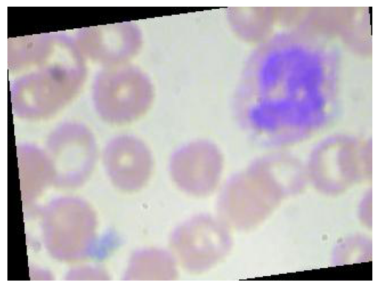
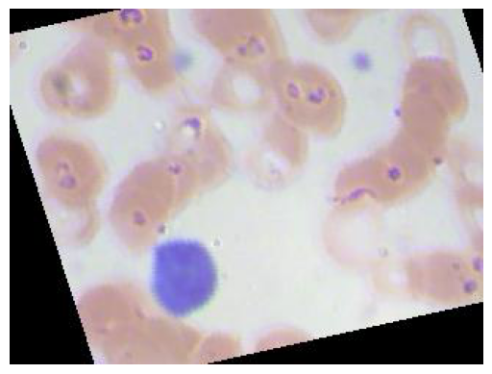
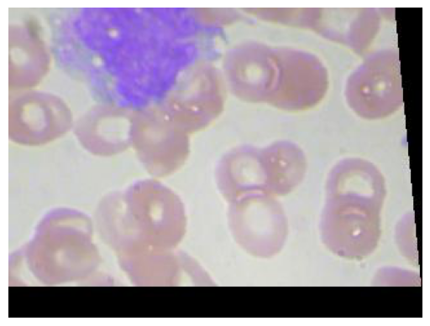
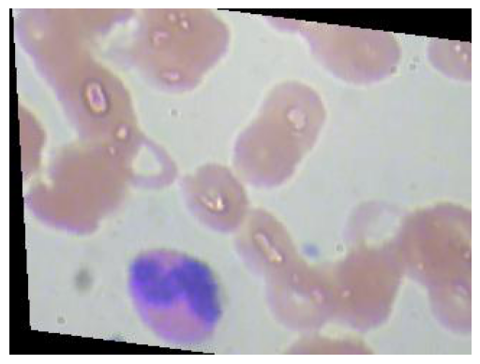
What do the cells look like?
Neutrophil
Lymphocyte
Monocyte
Eosinophil

Slide 4
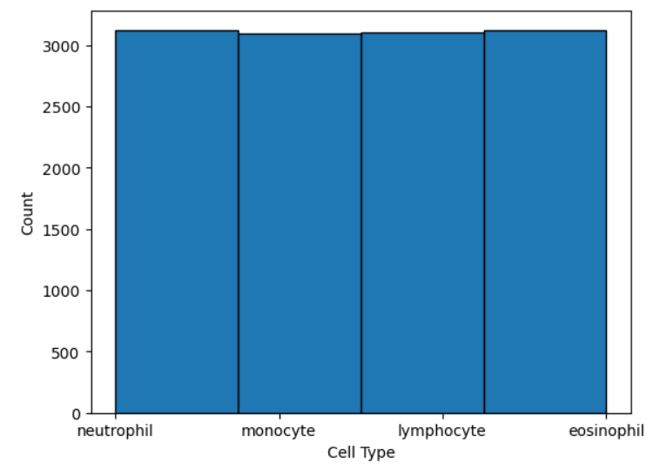
How many examples of each cell do we have?

Slide 5
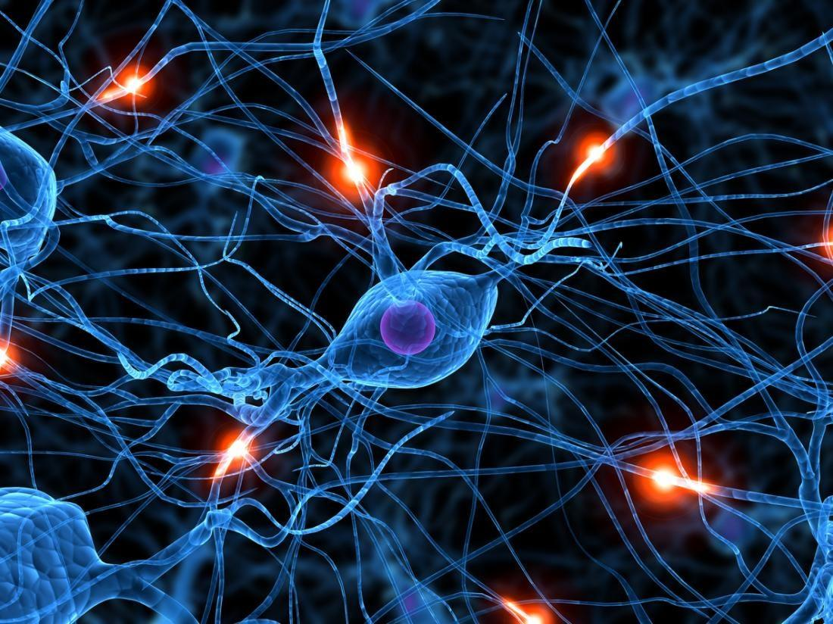
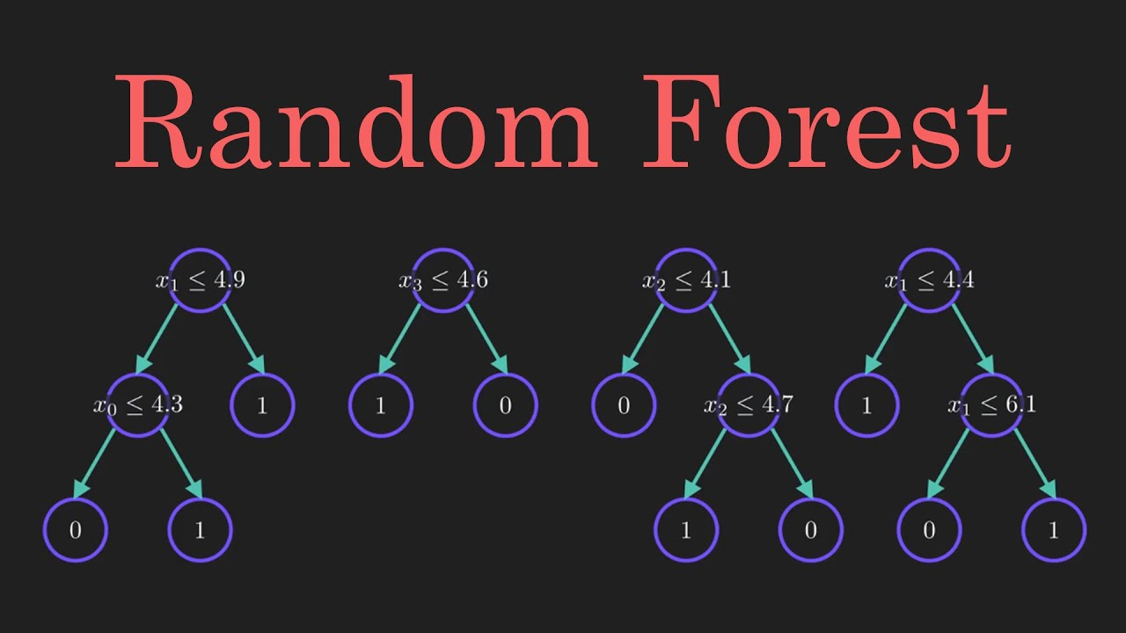
Which models did we try?

Slide 6
What was the Recall score for each model?
Efficient Net: 0.247
Neural Network: .569
Random Forest: .665

Slide 7

Which model won out?
Random Forest was slightly better than and built a lot faster than either neural network.

Slide 8

The Final Random Forest Model had a recall score of .685

Slide 9
Conclusions
Images take up a lot of memory and hardware issues became a concern
.68 is not great, especially when we’re talking about medical diagnosis
A reduced quality of images that was required by hardware limitations made it difficult for the Efficient Net to work effectively
I tried to run this in an EC2 with a GPU, but Amazon restricted my account.
I would like to rerun the models without hardware limitations

